Slide 1


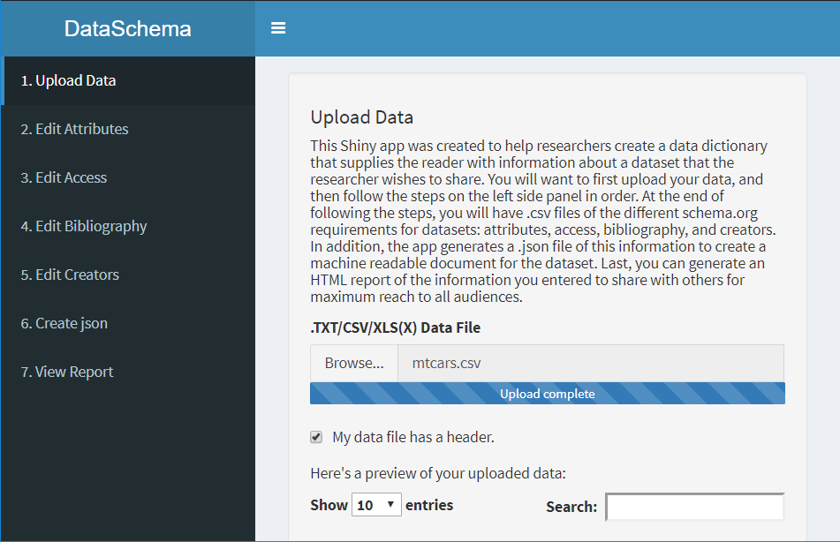
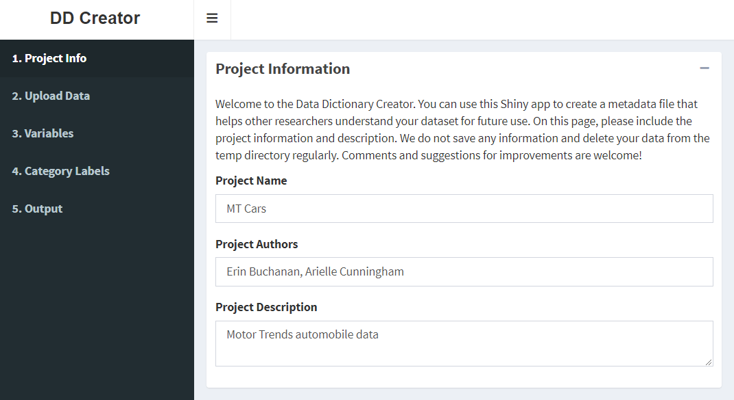
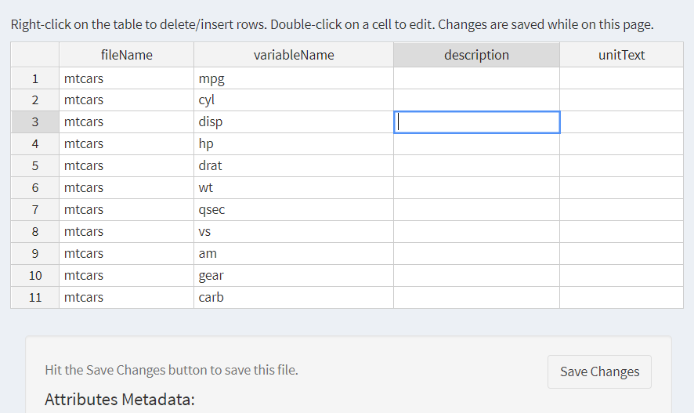
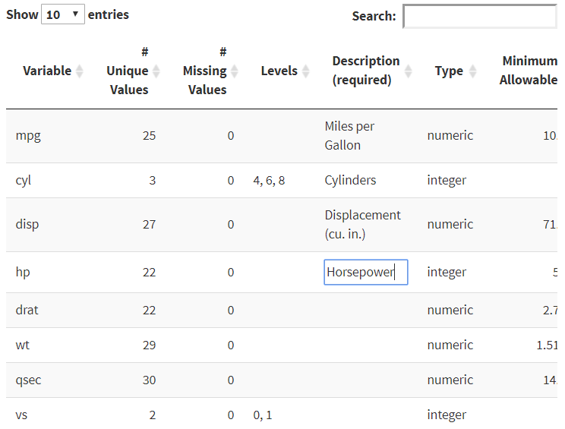
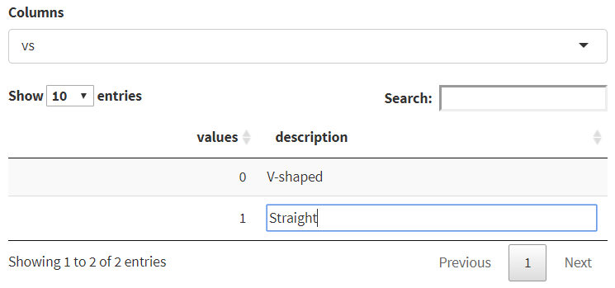
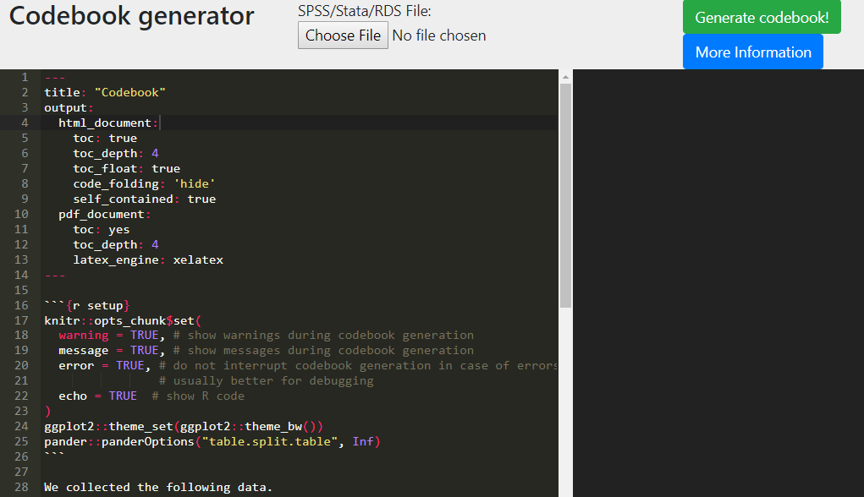
Getting Started Creating Data Dictionaries: Creating Shareable Datasets
Arielle Cunningham, Sarah E. Crain, Hannah R. Johnson, Hannah Stash, Erin M. Buchanan, PhD
Missouri State University
Summary
DataSchema
DD Creator
What is open science?
A collaborative effort to make the research process more public
Online platform created by Brian Nosek and Jeffrey Spies to openly record, report, and share data (Nelson, Simmons, & Simonsohn, 2018)¹
Open data discourages fraud and makes replication more likely (Piwowar, 2013) ²
Why data dictionaries?
Data dictionaries are documents that contain metadata about a dataset
They allow researchers to make data more open and easier to interpret
Several dictionary creation apps depending on researchers’ needs
 | Codebook | DataSchema | DD Creator
Citation | Arslan (2018) ³ | Inspired by Data Spice (Boettiger et al., 2018) ⁴ | (DeBruine, Buchanan, & Mohr, 2018) ⁵
Input | CSV, SPSS, Stata, RDS | CSV, Text, Excel, SPSS, SAS | CSV, Text, Excel, SPSS, SAS
Output | HTML report from Markdown | CSV files of meta-data, JSON, and HTML report | CSV files of meta-data, JSON, Rdata
Benefits | Easiest to use Quick metadata generation Generates a summary for each variable in a readable format | Follows schema.org for output Metadata entry is medium | Follows schema.org Specifies a separate section for category labels Rdata output More detailed descriptions, depending on data
DD Creator allows a user to enter metadata for each column provided in the dataset, while automatically providing a starting point for the number of unique values, missing values, variable type (i.e., character, numeric), and minimum/maximum values. A description of each column can be added, along with information about the levels/groups in the data and synonyms for the variables. On a separate page, category labels can be provided for both character and numeric data (i.e., Likert-type scales that include labeled numbers).
This application allows users to create an HTML report, a JSON file formatted following guidelines for datasets from schema.org, and .csv files of their metadata. JSON files are machine readable formats, which are encouraged for sharing. In this application, descriptions of the dataset properties (e.g., authors, collection dates) and column information should be entered to complete the metadata files.
Codebook
Screenshots of the data entry for DD Creator, including overall variable and individual level attributes. This app will be familiar to those who like SPSS.
Screenshot of the Attributes page, in which users can enter detailed information about the variables in their datasets.
References
Nelson, L. D., Simmons, J., & Simonsohn, U. (2018). Psychology’s Renaissance. Annual Review of Psychology, 69, 511–534. https://doi.org/10.1146/annurev-psych-122216-011836
Piwowar, H. A., & Vision, T. J. (2013). Data reuse and the open data citation advantage. PeerJ, 1, e175. https://doi.org/10.7717/peerj.175
Arslan, R. C. (2018). How to automatically generate rich codebooks from study metadata. https://doi.org/10.31234/osf.io/5qc6h
Boettiger, C., Chamberlain, S., Fournier, A., Hondula, K., Krystalli, A., Mecum, B., … Woo, K. (2018, October 10). dataspice. Retrieved November 24, 2018, from https://github.com/ropenscilabs/dataspice
DeBruine, L., Buchanan, E. M., & Mohr, A. H. (2018, July 1). ddcreator. Retrieved November 24, 2018, from https://github.com/debruine/ddcreator
For more information, please contact Arielle Cunningham at: arielle924@live.missouristate.edu
Check out the Open Science Page and research tutorial paper at: https://osf.io/3y2ex/
Check out the DataSchema code at: https://github.com/doomlab/shiny-server/tree/master/MOTE
Check out the DD Creator code at https://github.com/doomlab/data-dictionary/tree/master/ddcreator
Codebook is an R package with a corresponding website that allows researchers to create reports of their data, including reliabilities, summaries of items (histograms, descriptive statistics. Of the three available options, codebook is the quickest and easiest to implement; however, non computer savvy users would have trouble editing the automatically produced output if they wished to add more information.

